Slide 1

Chapter 3
Concurrent Execution

Slide 2
Concurrent execution
Concepts: processes - concurrent execution
and interleaving.
process interaction.
Models: parallel composition of asynchronous processes
- interleaving
  interaction - shared actions
process labeling, and action relabeling and hiding
structure diagrams
Practice: Multithreaded Java programs

Slide 3
Definitions
Concurrency
  Logically simultaneous processing.
  Does not imply multiple processing
  elements (PEs). Requires
  interleaved execution on a single PE.
Parallelism
  Physically simultaneous processing.
  Involves multiple PEs and/or
  independent device operations.
A
B
C
Time
Both concurrency and parallelism require controlled access to shared resources . We use the terms parallel and concurrent interchangeably and generally do not distinguish between real and pseudo-concurrent execution.

Slide 4
3.1 Modeling Concurrency
How should we model process execution speed?
  arbitrary speed
  (we abstract away time)
How do we model concurrency?
  arbitrary relative order of actions from different processes (interleaving but preservation of each process order )
What is the result?
  provides a general model independent of scheduling (asynchronous model of execution)

Slide 5
parallel composition - action interleaving
  If P and Q are processes then (P||Q) represents the concurrent execution of P and Q. The operator || is the parallel composition operator.
ITCH = (scratch->STOP).
CONVERSE = (think->talk->STOP).
||CONVERSE_ITCH = (ITCH || CONVERSE).
Disjoint alphabets
think→talk→scratch
think→scratch→talk
scratch→think→talk
Possible traces as a result of action interleaving.

Slide 6
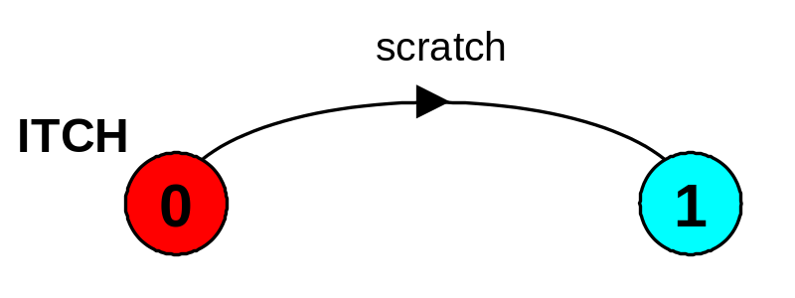
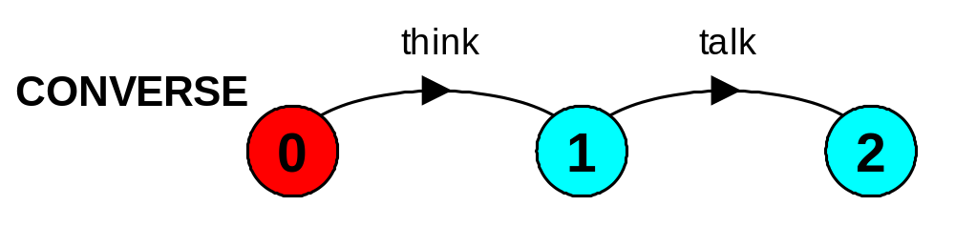
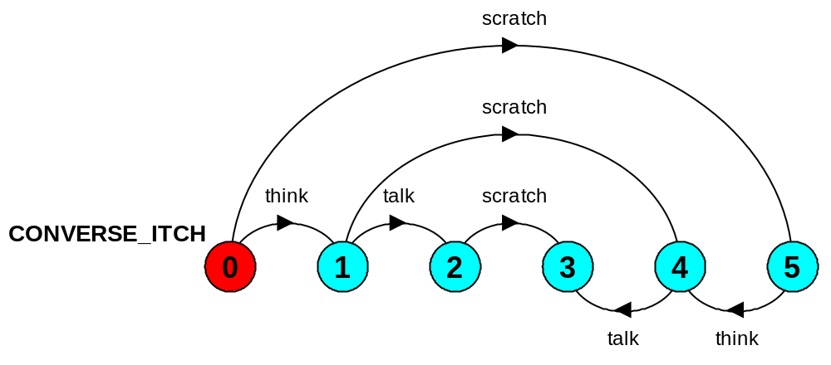
parallel composition - action interleaving
2 states
3 states
(0,0)
(0,1)
(0,2)
(1,2)
(1,1)
(1,0)
from ITCH
from CONVERSE
2 x 3 states
Scratch is concurrent with both think and talk while think must happen before talk.

Slide 7
parallel composition - action interleaving
Composite processes are defined as a Cartesian product of primitive processes.
Primitive processes are defined using action prefix and choice
Composite processes are defined using only parallel composition. The models described by FSP are finite.

Slide 8
parallel composition - algebraic laws
Commutative: (P||Q) = (Q||P)
Associative: (P||(Q||R)) = ((P||Q)||R)
= (P||Q||R).
Clock radio example:
CLOCK = (tick->CLOCK).
RADIO = (on->off->RADIO).
||CLOCK_RADIO = (CLOCK || RADIO).
Define: LTS? Traces? Number of states?

Slide 9
modeling interaction - shared actions
If processes in a composition have actions in common, these actions are said to be shared. Shared actions are the way that process interaction is modeled. While unshared actions may be arbitrarily interleaved, a shared action must be executed at the same time by all processes that participate in the shared action.
The actoin meet synchronizes the processes BILL and BEN.
BILL = (play->meet->STOP).
BEN = (work->meet->STOP).
||BILL_BEN = (BILL || BEN).
LTS? Traces? Number of states?
Non-disjoint alphabets

Slide 10
modeling interaction - shared actions
Manifacture an item - produce and then use:
MAKER = (make->ready->MAKER).
USER = (ready->use->USER).
||MAKER_USER = (MAKER || USER).
MAKER synchronizes with USER when ready.
LTS? Number of states?
Non-disjoint alphabets
make->ready->use->make->ready-> …
make->ready->make->use->ready-> …

Slide 11
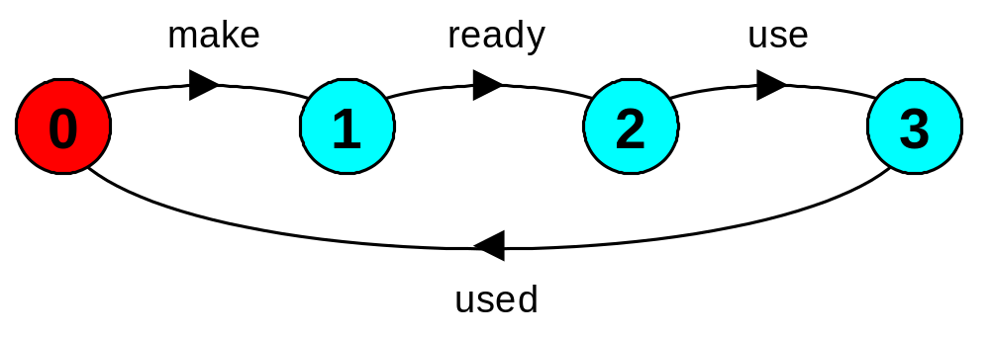
modeling interaction - handshake
A handshake is an action acknowledged by another:
MAKERv2 = (make->ready->used->MAKERv2).
USERv2 = (ready->use->used ->USERv2).
||MAKER_USERv2 = (MAKERv2 || USERv2).
3 states
3 states
3 x 3 states?
4 states
Interaction constrains the overall behaviour.

Slide 12
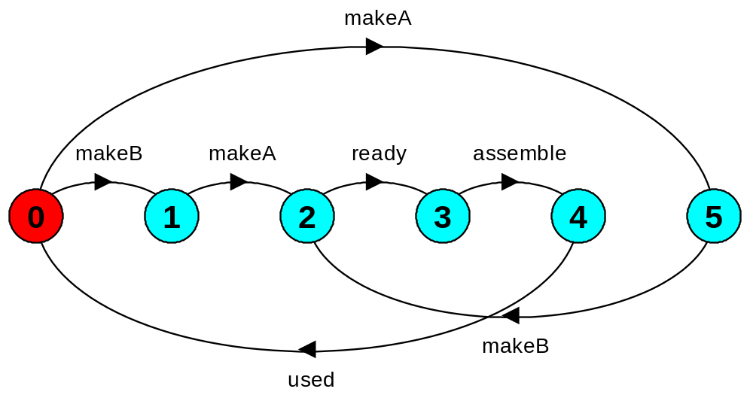
modeling interaction - multiple processes
Multi-party synchronization:
MAKE_A = (makeA->ready->used->MAKE_A).
MAKE_B = (makeB->ready->used->MAKE_B).
ASSEMBLE = (ready->assemble->used->ASSEMBLE).
||FACTORY = (MAKE_A || MAKE_B || ASSEMBLE).

Slide 13
composite processes
A composite process is a parallel composition of primitive processes. These composite processes can be used in the definition of further compositions.
||MAKERS = (MAKE_A || MAKE_B).
||FACTORY = (MAKERS || ASSEMBLE).
Substituting the definition for MAKERS in FACTORY and applying the commutative and associative laws for parallel composition results in the original definition for FACTORY in terms of primitive processes.
||FACTORY = (MAKE_A || MAKE_B || ASSEMBLE).

Slide 14
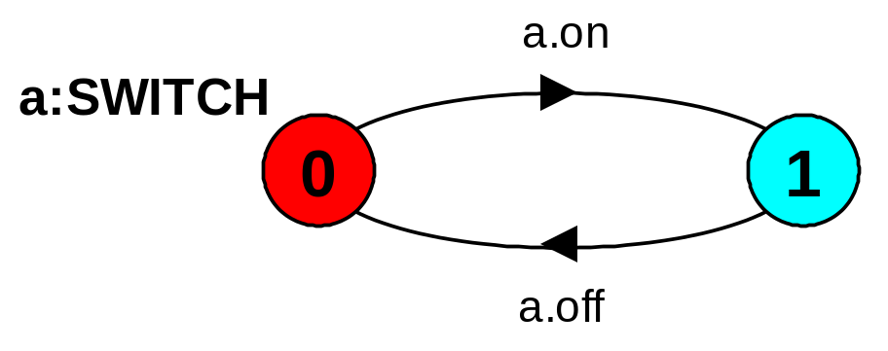

process instances and labeling
  a:P prefixes each action label in the alphabet of P with a.
Two instances of a switch process:
SWITCH = (on->off->SWITCH).
||TWO_SWITCH = (a:SWITCH || b:SWITCH).
An array of instances of the switch process:
||SWITCHES(N=3) = (forall[i:1..N] s[i]:SWITCH).
||SWITCHES(N=3) = (s[i:1..N]:SWITCH).

Slide 15
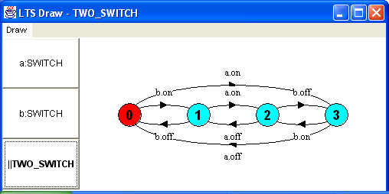

Slide 16
process labeling by a set of prefix labels
  {a1,..,ax}::P replaces every action label n in the alphabet of P with the labels a1.n,…,ax.n. Further, every transition (n->X) in the definition of P is replaced with the transitions ({a1.n,…,ax.n} ->X).
Process prefixing is useful for modeling shared resources:
RESOURCE = (acquire->release->RESOURCE).
USER = (acquire->use->release->USER).
||RESOURCE_SHARE = (a:USER || b:USER
|| {a,b}::RESOURCE).

Slide 17
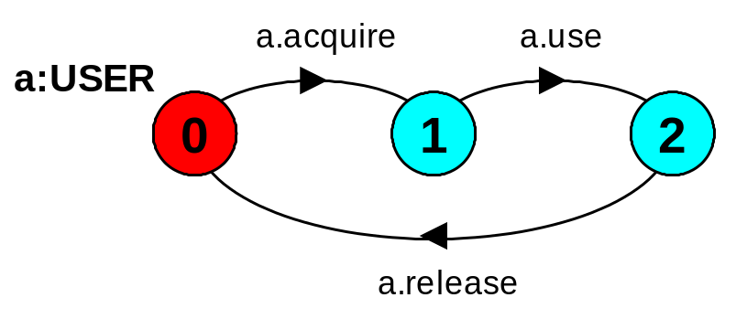
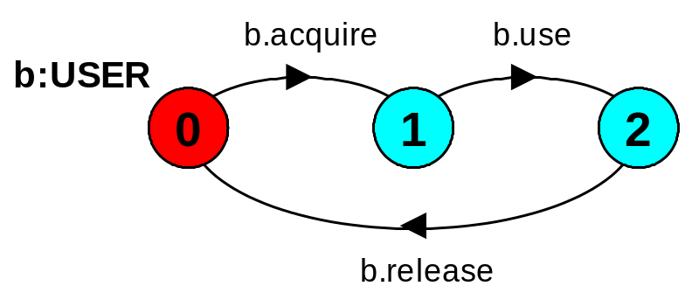
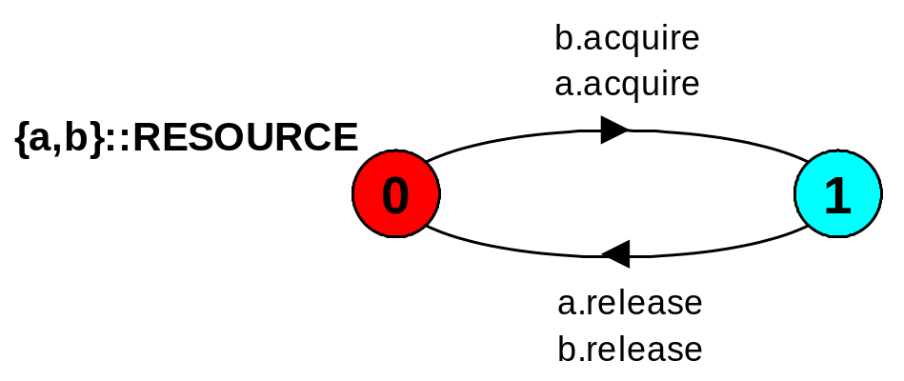
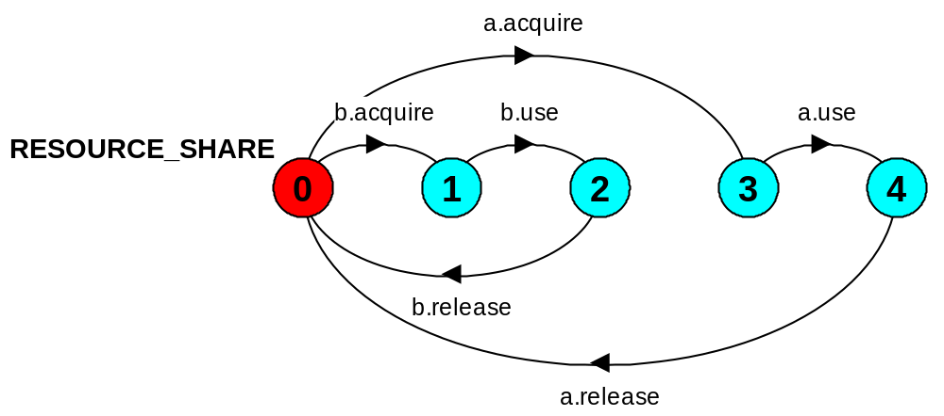
process prefix labels for shared resources
How does the model ensure that the user that acquires the resource is the one to release it?
Mutual exclusion

Slide 18
action relabeling
  Relabeling functions are applied to processes to change the names of action labels. The general form of the relabeling function is:
  /{newlabel_1/oldlabel_1,… newlabel_n/oldlabel_n}.
Relabeling to ensure that composed processes synchronize on particular actions.
CLIENT = (call->wait->continue->CLIENT).
SERVER = (request->service->reply->SERVER).
Note that both newlabel and oldlabel can be sets of labels.

Slide 19
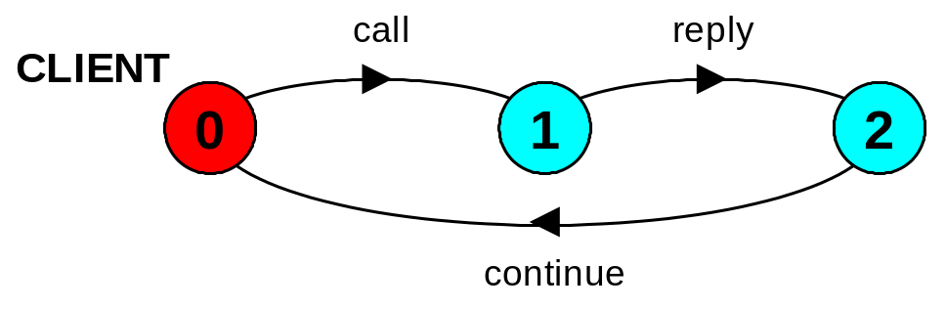
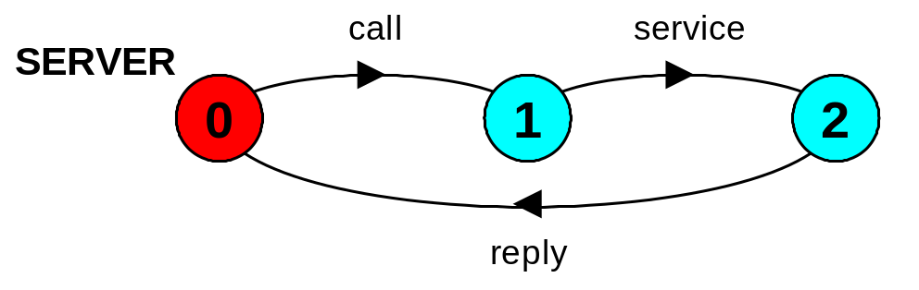
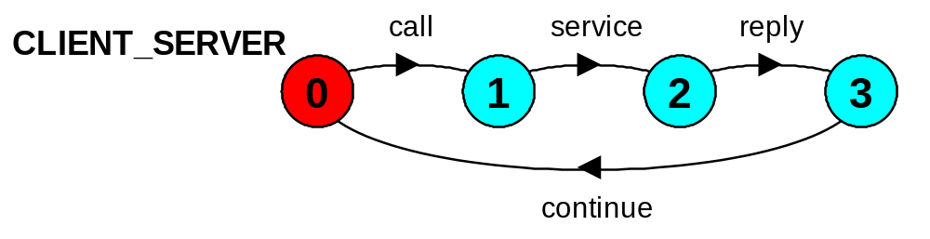
action relabeling
||CLIENT_SERVER = (CLIENT || SERVER)
/{call/request, reply/wait}.

Slide 20
action relabeling - prefix labels
An alternative formulation of the client server system is described below using qualified or prefixed labels:
SERVERv2 = (accept.request
->service->accept.reply->SERVERv2).
CLIENTv2 = (call.request
->call.reply->continue->CLIENTv2).
||CLIENT_SERVERv2 = (CLIENTv2 || SERVERv2)
/{call/accept}.
The relabeling function /{call/accept} replaces any label prefixed by
accept with the same label prefixed by call.

Slide 21
action hiding - abstraction to reduce complexity
  When applied to a process P, the hiding operator \{a1..ax} removes the action names a1..ax from the alphabet of P and makes these concealed actions "silent". These silent actions are labeled tau. Silent actions in different processes are not shared.
Sometimes it is more convenient to specify the set of labels to be exposed....
  When applied to a process P, the interface operator @{a1..ax} hides all actions in the alphabet of P not labeled in the set a1..ax.

Slide 22
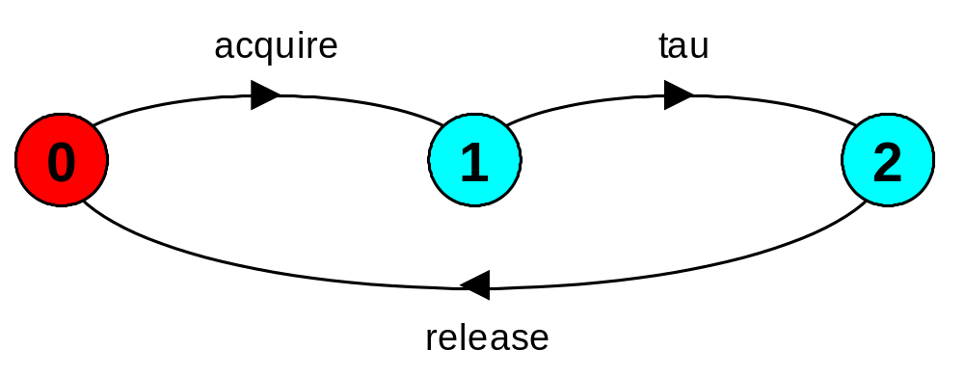
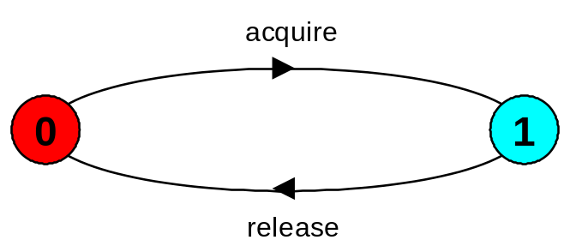
action hiding
The following definitions are equivalent:
USER = (acquire->use->release->USER)
\{use}.
USER = (acquire->use->release->USER)
    @{acquire,release}.
Minimization removes hidden tau actions to produce an LTS with equivalent observable behavior.

Slide 23
structure diagrams – systems as interacting processes
P
a
Process P with
alphabet {a,b}.
b
P
m
b
Q
a
Parallel Composition
(P||Q) / {m/a,m/b,c/d}
c
c
d
x
x
x
S
Composite process
||S = (P||Q) @ {x,y}
x
P
a
Q
y

Slide 24
structure diagrams
We use structure diagrams to capture the structure of a model expressed by the static combinators: parallel composition, relabeling and hiding.
range T = 0..3
BUFF = (in[i:T]->out[i]->BUFF).
Describe: ||TWOBUF = ?
= (a:BUFF||b:BUFF)
/{in/a.in, a.out/b.in,
out/b.out} @{in,out}.
TWOBUFF
a:BUFF
b:BUFF
in
a.out
out
in
out
in
out

Slide 25
Exercises: structure diagrams
Structure diagram for CLIENT_SERVER ?
CLIENT
call
request
SERVER
call
continue
wait
reply
reply
service
Structure diagram for CLIENT_SERVERv2 ?
CLIENTv2
call
accept
SERVERv2
call
continue
service

Slide 26
structure diagrams - resource sharing
PRINTER_SHARE
a:USER
printer
printer:
RESOURCE
acquire
b:USER
release
printer
RESOURCE = (acquire->release->RESOURCE).
USER = (printer.acquire->use
->printer.release->USER)\{use}.
||PRINTER_SHARE
= (a:USER||b:USER||{a,b}::printer:RESOURCE).

Slide 27
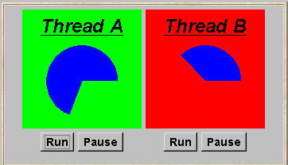
3.2 Multi-threaded Programs in Java
Concurrency in Java occurs when more than one thread is alive. ThreadDemo has two threads which rotate displays.

Slide 28
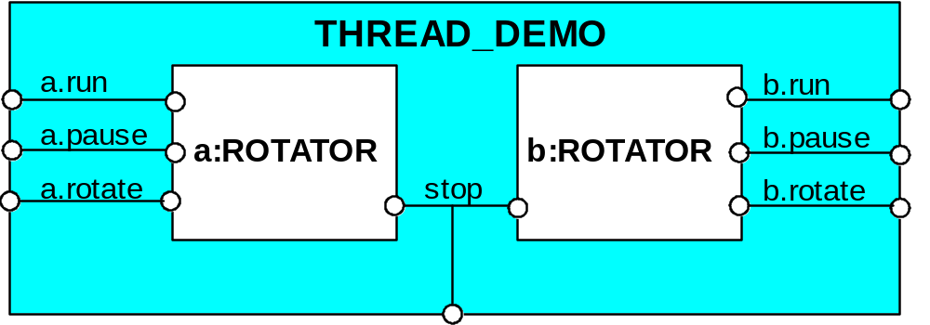
ThreadDemo model
ROTATOR = PAUSED,
PAUSED = (run->RUN | pause->PAUSED
|interrupt->STOP),
RUN = (pause->PAUSED |{run,rotate}->RUN
|interrupt->STOP).
||THREAD_DEMO = (a:ROTATOR || b:ROTATOR)
/{stop/{a,b}.interrupt}.
Interpret run, pause, interrupt as inputs, rotate as an output.

Slide 29
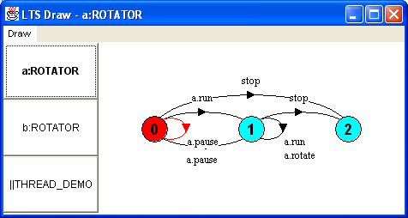
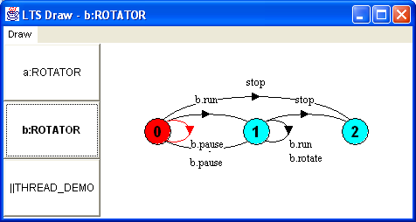
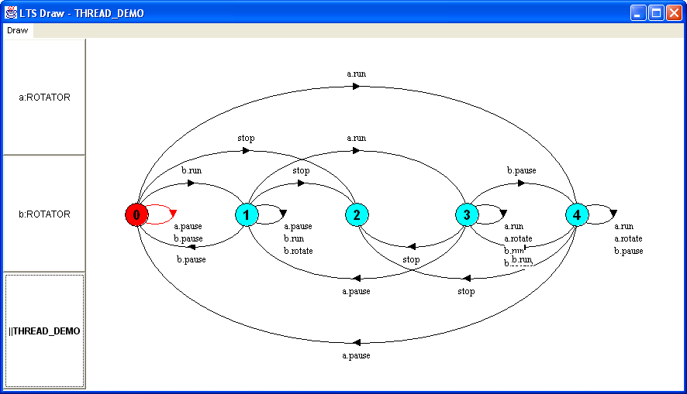
ThreadDemo implementation in LTSA

Slide 30
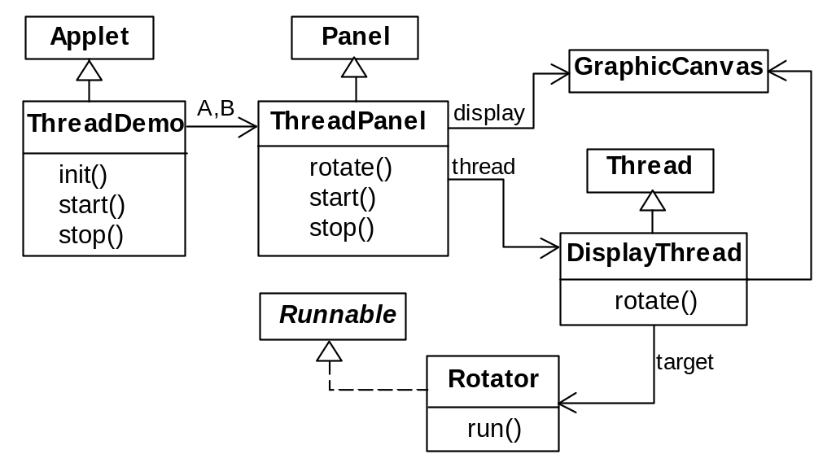
ThreadDemo implementation in Java - class diagram
ThreadDemo creates two ThreadPanel displays when initialized. ThreadPanel manages the display and control buttons, and delegates calls to rotate() to DisplayThread. Rotator implements the runnable interface.

Slide 31
Rotator class
class Rotator implements Runnable {
public void run() {
try {
while(true) ThreadPanel.rotate();
} catch(InterruptedException e) {}
}
}
Rotator implements the runnable interface, calling ThreadPanel.rotate() to move the display.
run()finishes if an exception is raised by Thread.interrupt().

Slide 32
ThreadPanel class
ThreadPanel manages the display and control buttons for a thread.
public class ThreadPanel extends Panel {
// construct display with title and segment color c
public ThreadPanel(String title, Color c) {…}
// rotate display of currently running thread 6 degrees
// return value not used in this example
public static boolean rotate()
throws InterruptedException {…}
// create a new thread with target r and start it running
public void start(Runnable r) {
thread = new DisplayThread(canvas,r,…);
thread.start();
}
// stop the thread using Thread.interrupt()
public void stop() {thread.interrupt();}
}
Calls to rotate() are delegated to DisplayThread.
Threads are created by the start() method, and terminated by the stop() method.

Slide 33
ThreadDemo class
public class ThreadDemo extends Applet {
ThreadPanel A; ThreadPanel B;
public void init() {
A = new ThreadPanel("Thread A",Color.blue);
B = new ThreadPanel("Thread B",Color.blue);
add(A); add(B);
}
public void start() {
A.start(new Rotator());
B.start(new Rotator());
}
public void stop() {
A.stop();
B.stop();
}
}
ThreadDemo creates two ThreadPanel displays when initialized and two threads when started.
ThreadPanel is used extensively in later demonstration programs.

Slide 34
Summary
Concepts
  concurrent processes and process interaction
Models
  Asynchronous (arbitrary speed) & interleaving (arbitrary order).
  Parallel composition as a finite state process with action interleaving.
  Process interaction by shared actions.
  Process labeling and action relabeling and hiding.
  Structure diagrams
Practice
  Multiple threads in Java.

